Slide 1
The HKU Scholars Hub
香港大学学术库
Aligned with HKU’s Mission, Vision & Strategic Plan
为配合香港大学的使命、抱负及策略计划而建
Library Leadership Institute
23 ~ 27 Apr 2010

Slide 2
HKU: Vision 香港大学的抱负
The University of Hong Kong, as a leading international institution of higher learning in Asia, strives to attract and nurture outstanding scholars from around the world through excellence and innovation in teaching and learning, research and knowledge exchange, contributing to the advancement of society and the development of leaders through a global presence, regional significance and engagement with the rest of China.
香港大学跻立国际优等学府之首列，标领亚洲，怀抱中华，旷眼世界。教学科研，是必竭心悉力，交流广益。期勉于精上求精，开新启昧，荟萃天下英才，教以成美，树人淑世，明德新民，止于至善。

Slide 3
HKU: Mission 香港大学的使命
The University of Hong Kong will endeavour:
  To…
  To…
  To be fully accountable for the effective management of public and private resources bestowed upon the institution and act in partnership with the community over the generation, dissemination and application of knowledge
  To serve as a focal point of intellectual and academic endeavour in Hong Kong, China and Asia and act as a gateway and forum for scholarship with the rest of the world
香港大学将全力以赴，以求达到下列目标：
  To…
  To…
  有效管理来自政府及民间的资源，与社会携手合作，拓展知识，并加以传扬和应用
  使港大成为香港、中国及亚洲的学术活动中心，加强才智交流，并致力促进与世界其他地区的学术联系

Slide 4
HKU: Strategic Development 2009 ~ 2014
2009 ~ 2014 策略方針
“We will continue to inculcate in our academic staff members a culture of knowledge sharing with the public. “They will be encouraged to share their intellectual knowledge through public and inaugural lectures, media interviews, publications…”
“我们将继续于港大教职员之间推广公众共享知识的文化，鼓励他们透过公开讲座、就职演讲、媒体访问、刊物 ……分享其知识……”
Operational Priority: “… setting up a database to record knowledge exchange activities in the University and improving communication within and outside the University, we will facilitate dissemination of information and serve as an exchange hub.”
实施重点：“建立数据库，记录港大的知识交流活动，并加强大学对内对外的沟通，促进信息传播并担当交流中心的角色。”

Slide 5
Knowledge Transfer (KT) ➔ KE
知识转移 ➔知识交流
HK University Grants Committee
HK$50M / year to 8 institutions
  “the systems and processes by which knowledge including technology, know-how, expertise and skills are transferred between higher education institutions and society, leading to innovative, profitable or economic or social improvements”
HKU’s interpretation of KT is KE, emphasizing a two exchange between HKU and its community
香港大学教育资助委员会
每年5仟万港币予8间院校
  “在高等教育院校和社会之间转移知识（包括科技、技术、专业知识及技能，所用的系统和方法），从而带动经济上或民生上的效益， 与及带来创新及有经济效益的活动。”
港大将知识转移演译为知识交流，着重于大学与社会间的双向交流。

Slide 6
The HKU Scholars Hub
香港大学学术库
To collect, preserve and provide open access to the intellectual output of HKU
2008/2009
  25,000 items
  Over 1M downloads
➔ Now, it must become an “exchange hub” for KE, to make HKU research & expertise highly visible
收集、保存港大的学术成果产出及为其提供公开存取
2008/2009
  25,000 项
  下载超过一百万次
➔ 现在，有必要将其变成知识交流的“交流中心”令港大的研究及专门领域更易于搜找

Slide 7
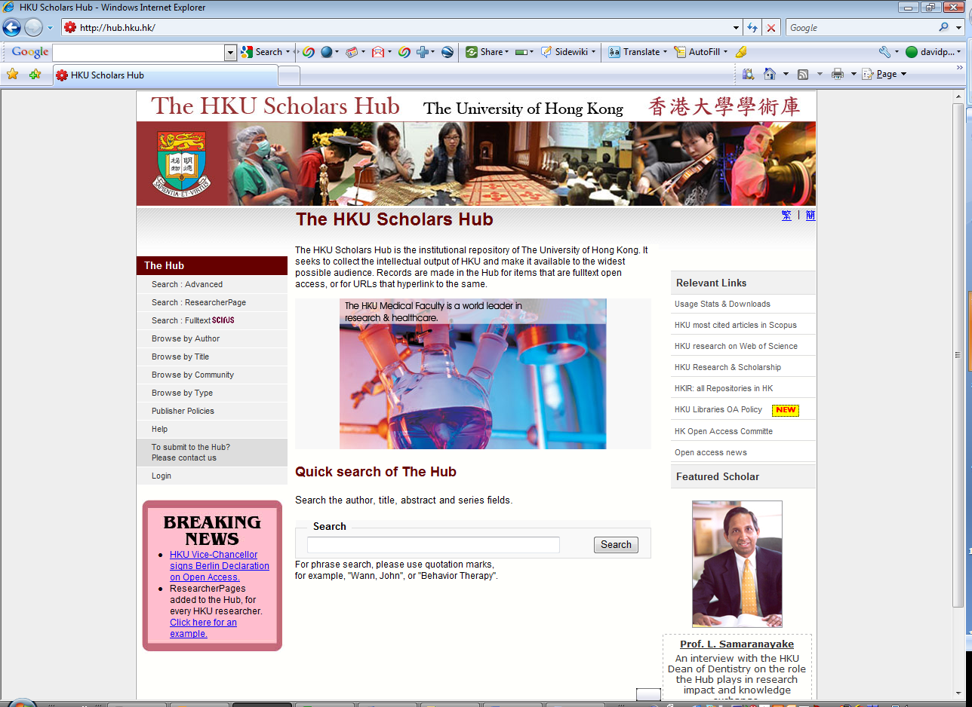

Slide 8
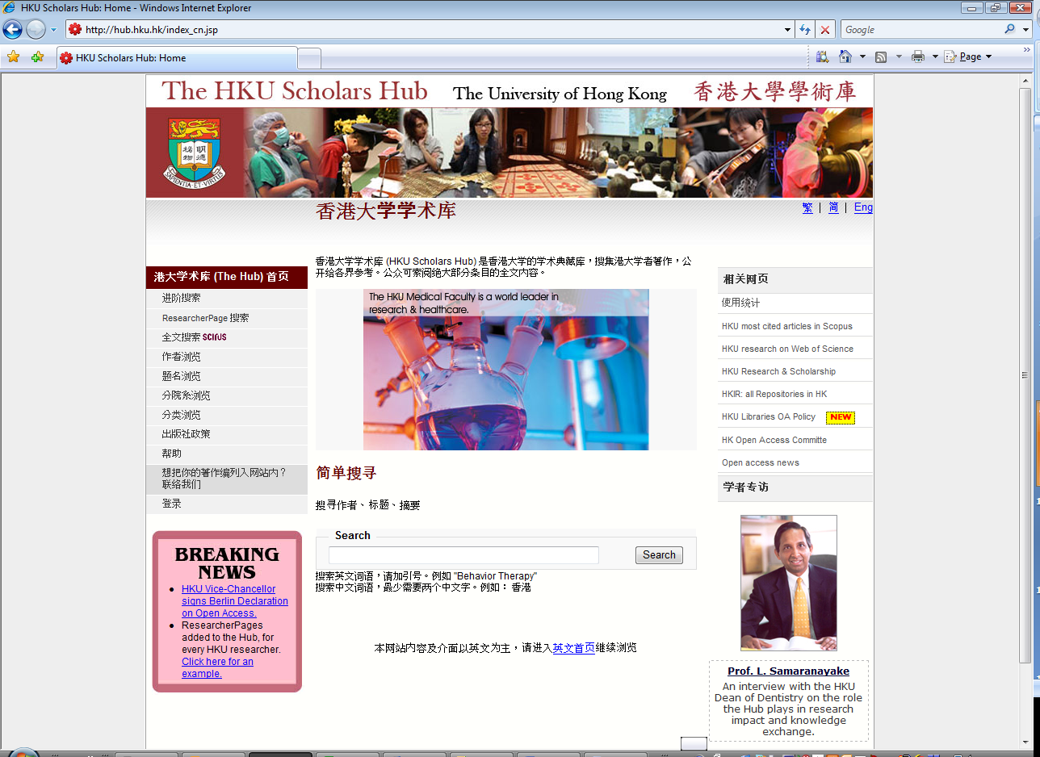

Slide 9
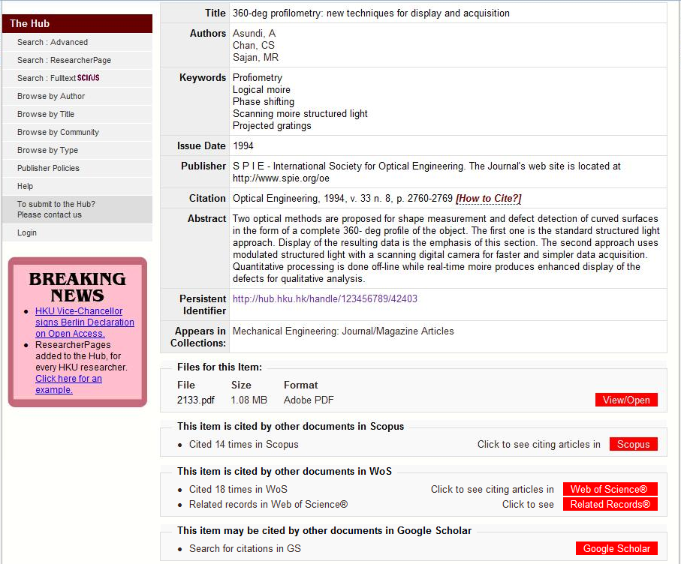
Before: The Hub was article-centric
以前，学术库主要收集文章

Slide 10
HKU ResearcherPages
港大研究者頁
Created for every current HKU researcher; 2,000+
Knowledge Exchange:
  A database in which government, industry and the community can easily find an HKU expert for media comment, contract research, collaboration, etc.
Our development Partner
  Cilea, Consorzio Interuniversitario
    www.cilea.it
为港大2,000名以上的所有现任研究人员而设
知识交流:
  是一个港大专才参与，让政府、工业界及社会易于查询媒体评论、合同研究及合作等等的数据库
我们的发展伙伴
  Cilea, Consorzio Interuniversitario
    www.cilea.it

Slide 11
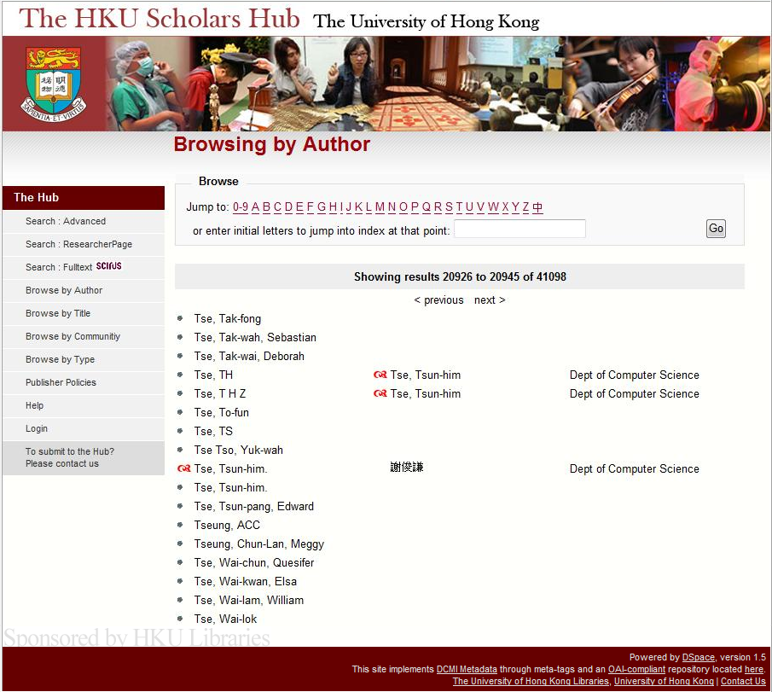

Authority Control
规范控制
Hierarchy of Authority & Synonymy
  Authorized headings
  Variant headings
Multi-script Synonymy
  Roman, Traditional Chinese, Simplified Chinese, Japanese, Korean, etc. (UTF-8)
规范及同义字的阶层
  规范标目
  变体标目
多种语言同义字
  罗马字、中国繁体字、中国简体字、日本字、韩国字

Slide 12
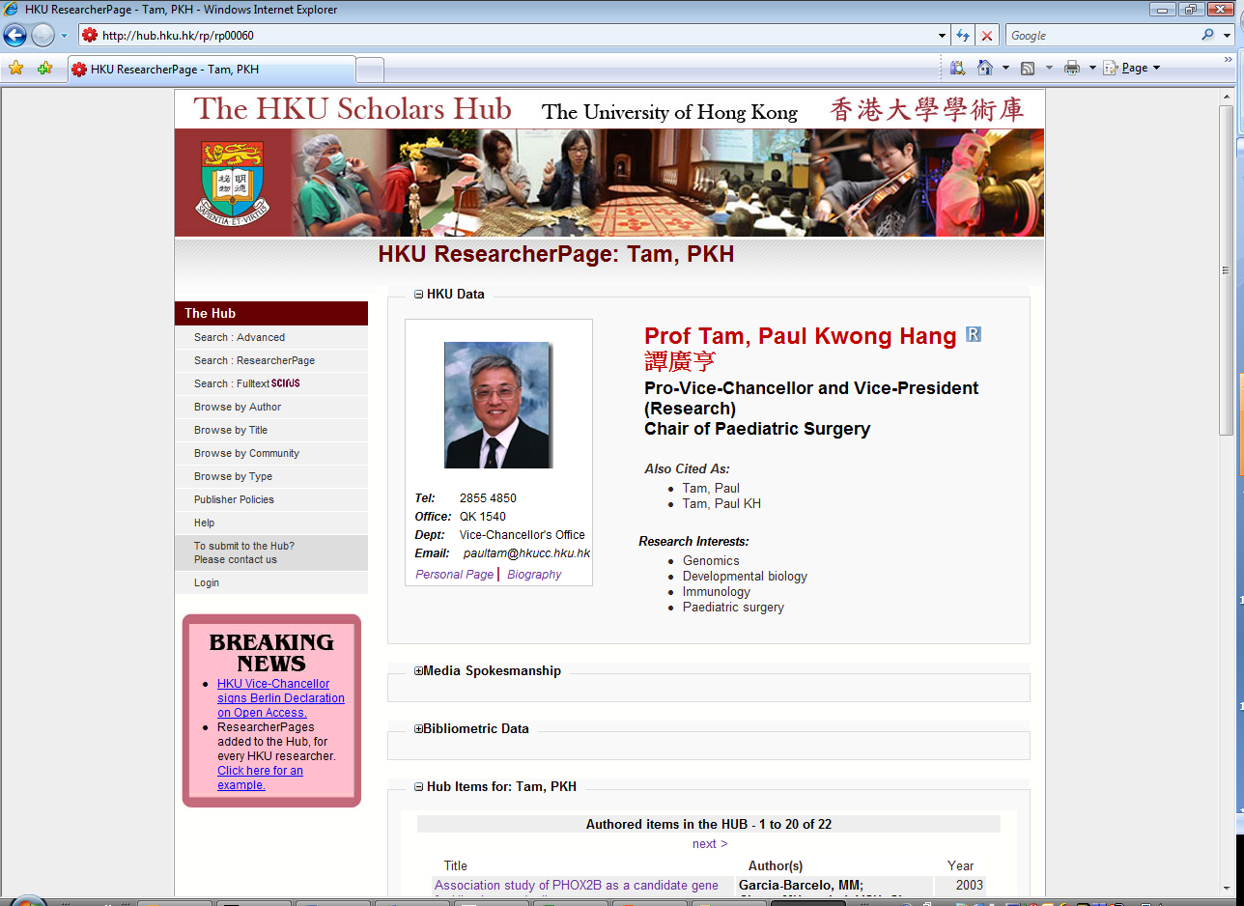
通过这些接入点可在Google找到谭教授的踪迹：名字、部门、职位、发言、写过的文章及其主题等等
Access points by which Prof Tam can be discovered (in Google!): names, dept, position, languages spoken, papers written, their subjects, etc.

Slide 13
Marshal Data for Upload
整理资料准备上载
Name & Contact Details
  HKU Communications Directory
Picture & Biography
  Departmental web pages
Media Spokesmanship
  HKU Communications & Public Affairs Office
Metrics
  Scopus & ResearcherID
Native silo ➔ Visual Studio ➔ Excel ➔ XML ➔ The Hub
名字及联络资料
  港大通讯录
相片及简传
  部门网页
媒体发言人
  港大传讯及公共事务处
计量
  Scopus & ResearcherID
原生型储存➔ Visual Studio ➔ Excel ➔ XML ➔ The Hub

Slide 14
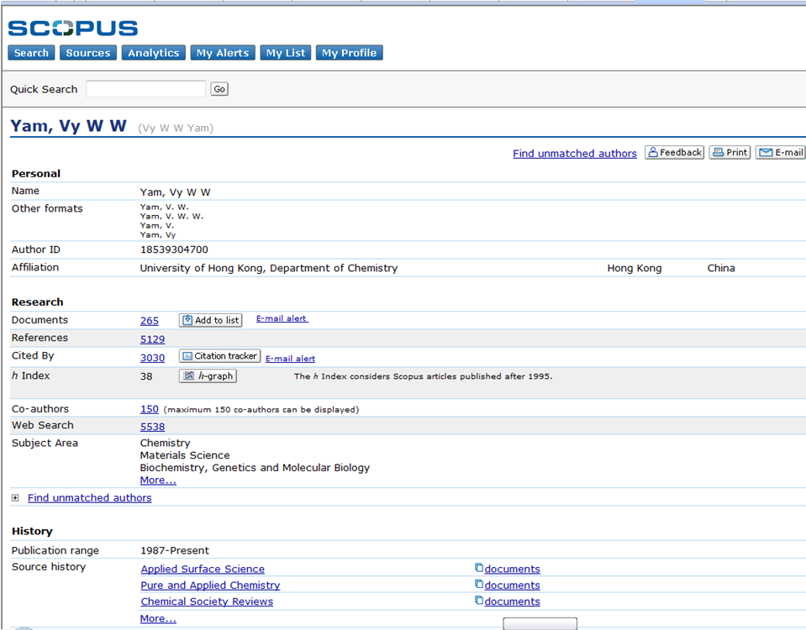
Metrics : Scopus
计量指标：Scopus
Project: Scopus Bibliometric Rectification
  1,000 HKU researcher names
  Disambiguate like named individuals
  Unify variant names for one individual
项目：Scopus计量指标修正
  1,000个港大研究者的名字
  消解重名
  统一同人异名

Slide 15
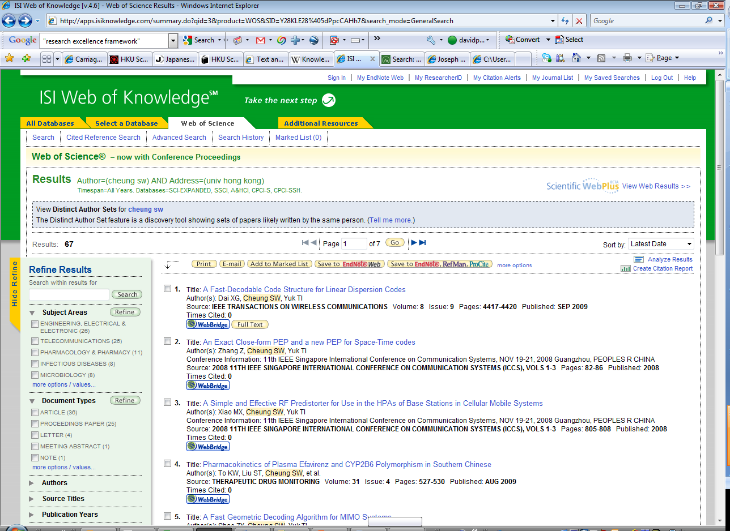
Metrics: Web of Knowledge
计量指标：学术信息资源整合体系
No authorized headings for personal or institution names
Serious Search Noise
  University of HK
  Chinese University of HK
  City University of HK
  HK U of Sci & Tech
  Etc.
个人或机构名字的规范标目
搜索中遇到的严重滋扰
  香港大学图书馆
  中文大学图书馆
  城市大学图书馆
  香港科技大学图书馆
  等等

Slide 16
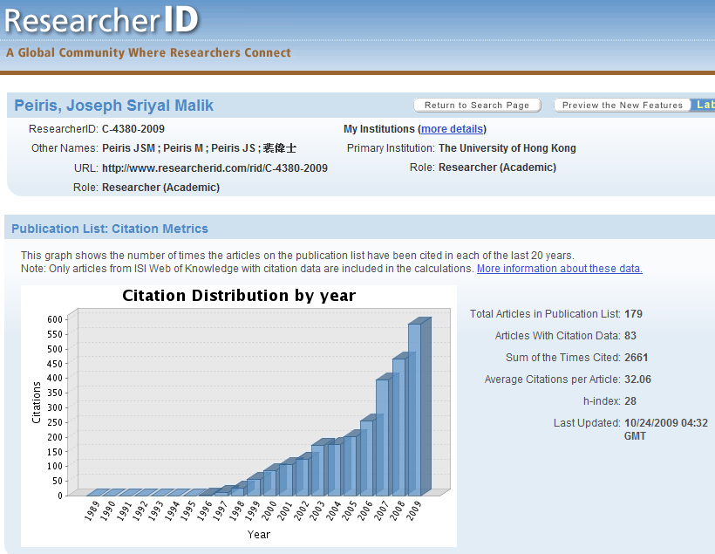
Metrics /计量指标 www.researcherID.com
Project: RID Batch Creation
  1,000 HKU researcher names
  Upload all publications
  Auto match on WoK
Results: Exact Search & Deep linking to RID pages
项目：成批制作RID
  1,000港大研究者的名字
  上载所有出版物
  在WoK上自动配对
结果：确切的搜索及深链接到RID网页

Slide 17



Web Services to
Integrate with Workflow
网络服务与
工作流程整合
Institution automatically creates RID profiles
研究机构可自行建立RID档案
Unique identifier for each researcher
Researchers maintain control of information and privacy
Current updated Web of Science citation counts into institutional repositories and systems
研究人员独一无二的识别账号
研究人员自行维护并控制个人信息
将及时更新Web of Science 引文数据引入机构智库和系统
Updated citation counts, profile and publication data flow into institutions
及时更新的引文数据，个人概况和发表的论文数据汇总于研究机构
HKU
港大
Slide, courtesy of Thomson Reuters.
由Thomson Reuters 提供的幻灯片

Slide 18
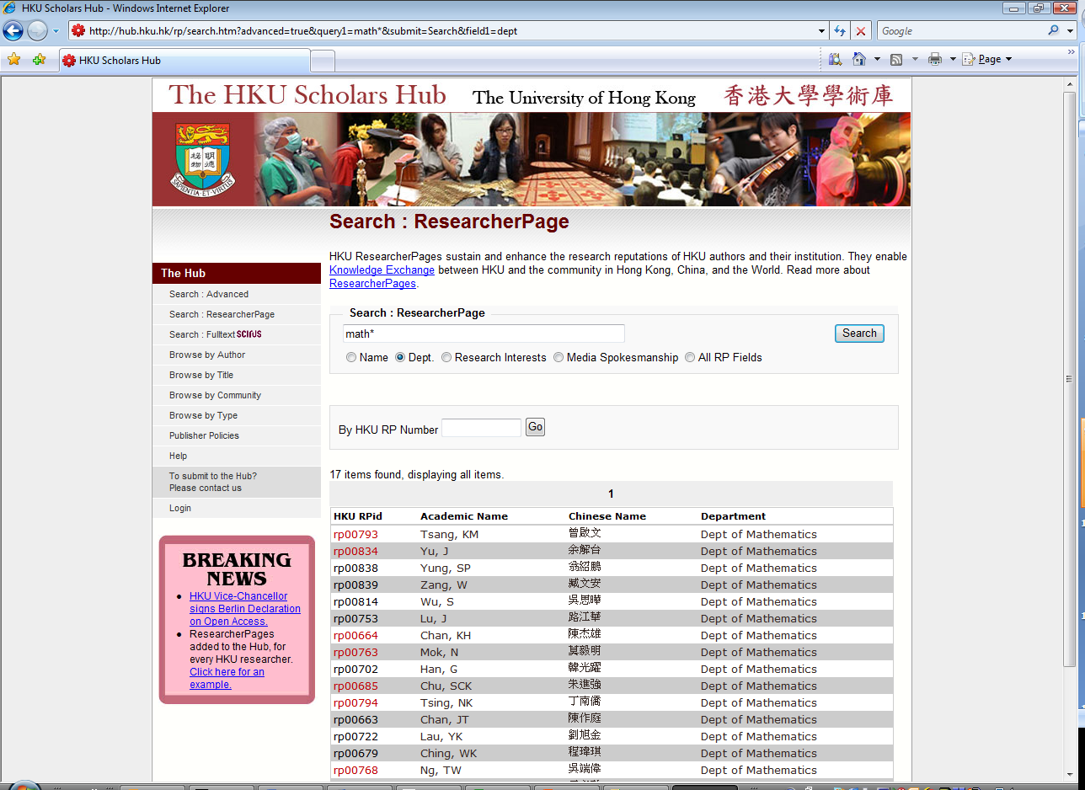
New index, many ways to search
新索引，多种搜索方法

Slide 19
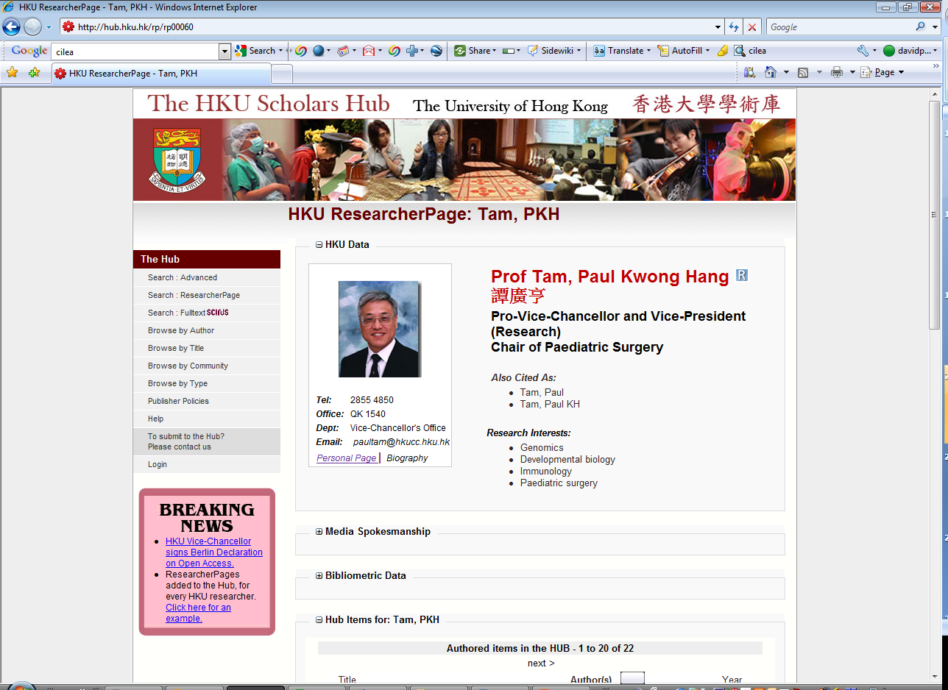
Collapse Button
Expand Button
折叠按钮
扩展按钮

Slide 20
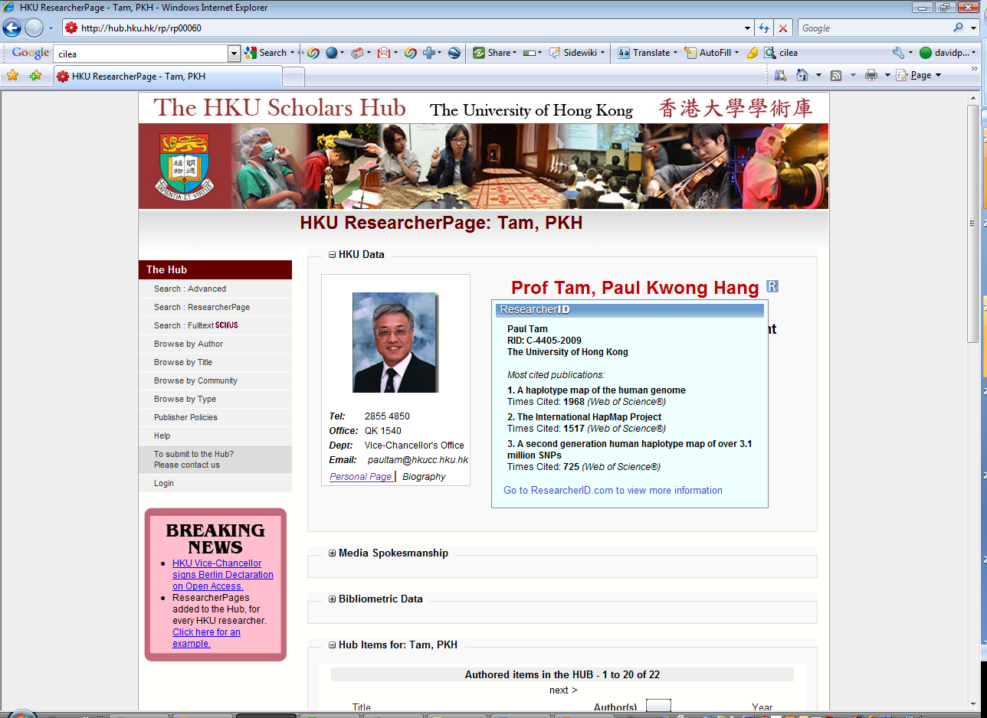
MouseOver on “R” produces popup
鼠标悬停在“R”会出现一个弹出窗口

Slide 21
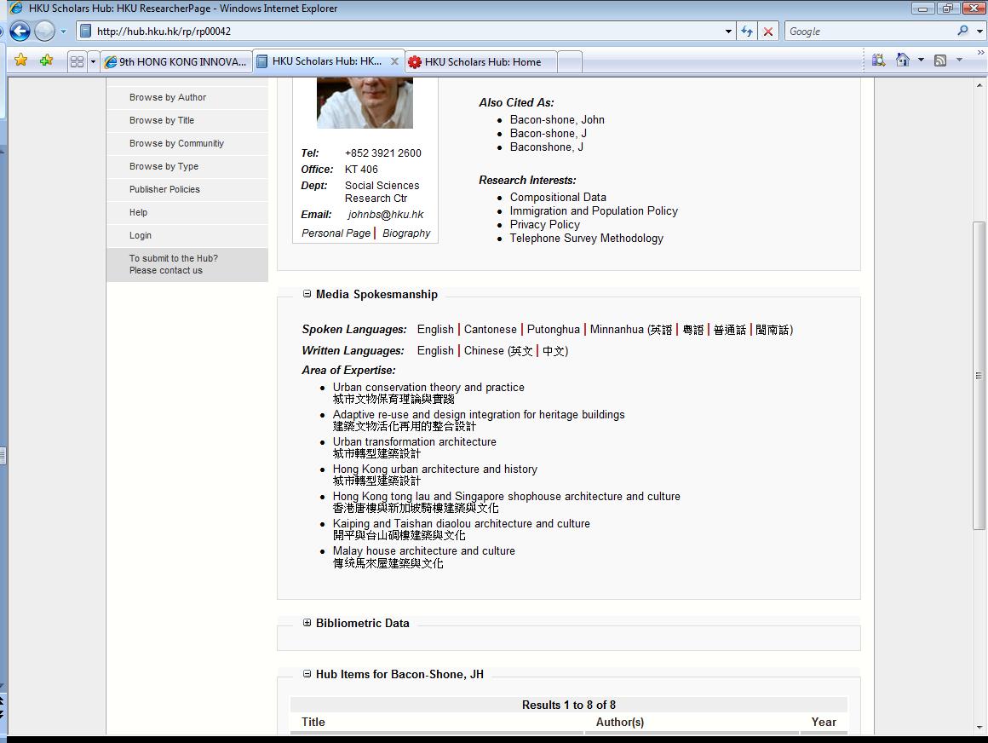
Media Spokesmanship
媒体发言

Slide 22
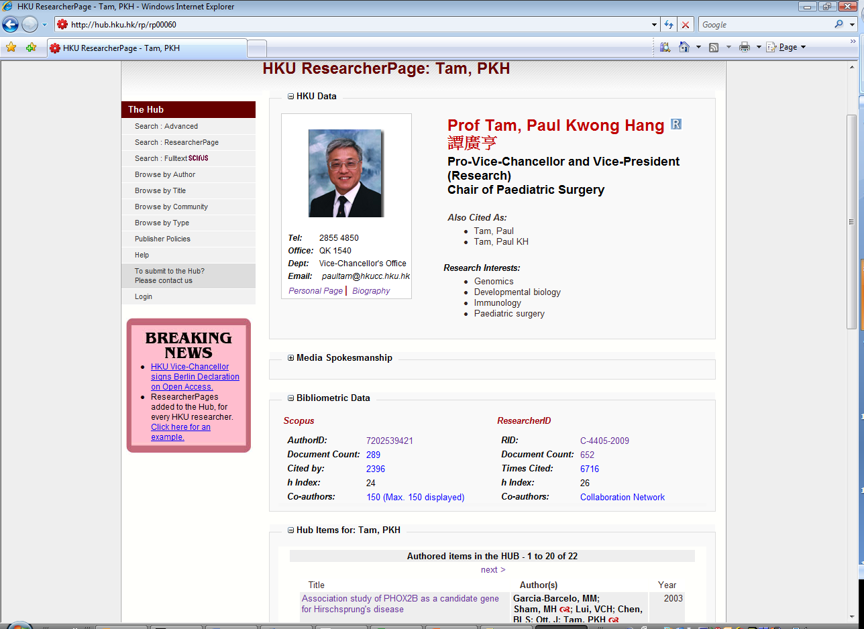
Clickable bibliometric counts from Scopus & ResearcherID
可点击以Scopus及ResearcherID计算的计量指标

Slide 23
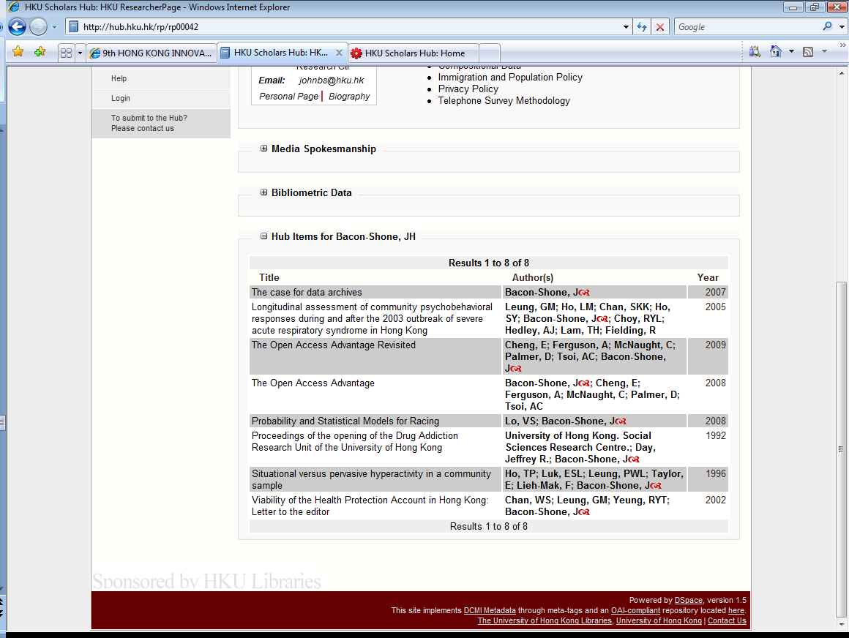
OA fulltext items in the Hub for this author
“d” indicates there is a RP.
该作者在此学术库开放存取的所有全文项目
“d”显示有RP

Slide 24

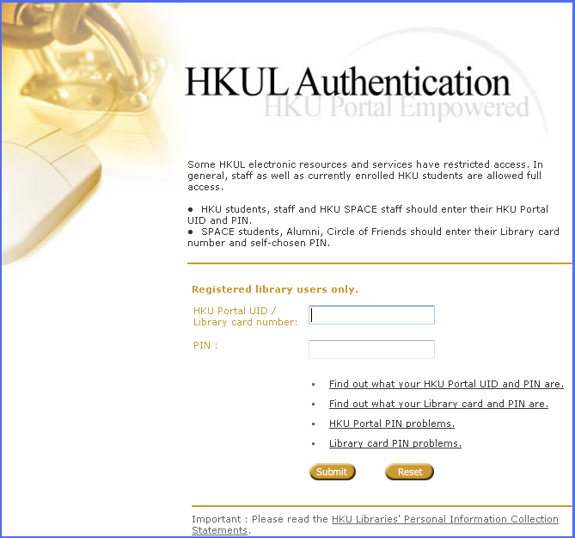
User Authentication
用户认证
HKU Single Sign-on (SSO / CAS)
港大单一登入(SSO / CAS)

Slide 25
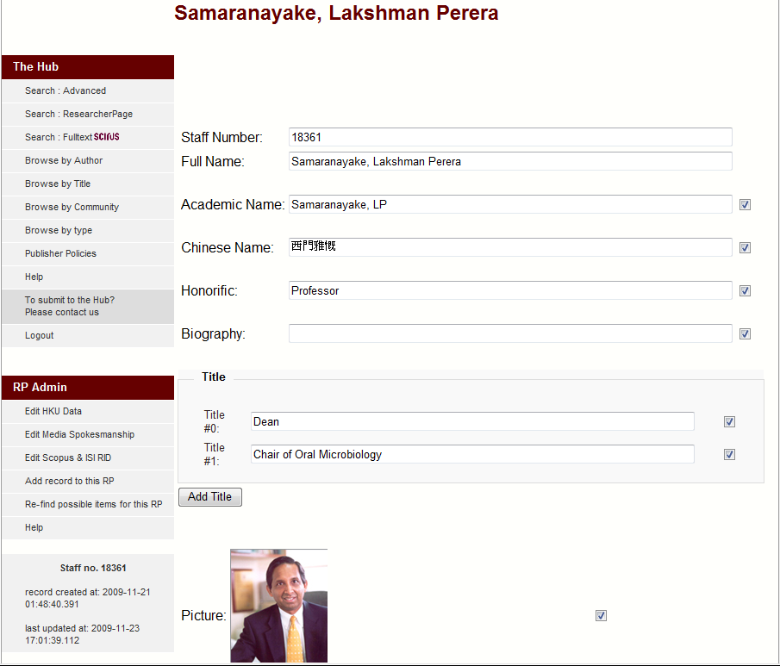
Staff Mode
职员模式
Each RP owner can,
  Edit
  Add
  Delete
  Hide
每一RP的主人可
  更改
  加入
  删除
  隠藏

Slide 26
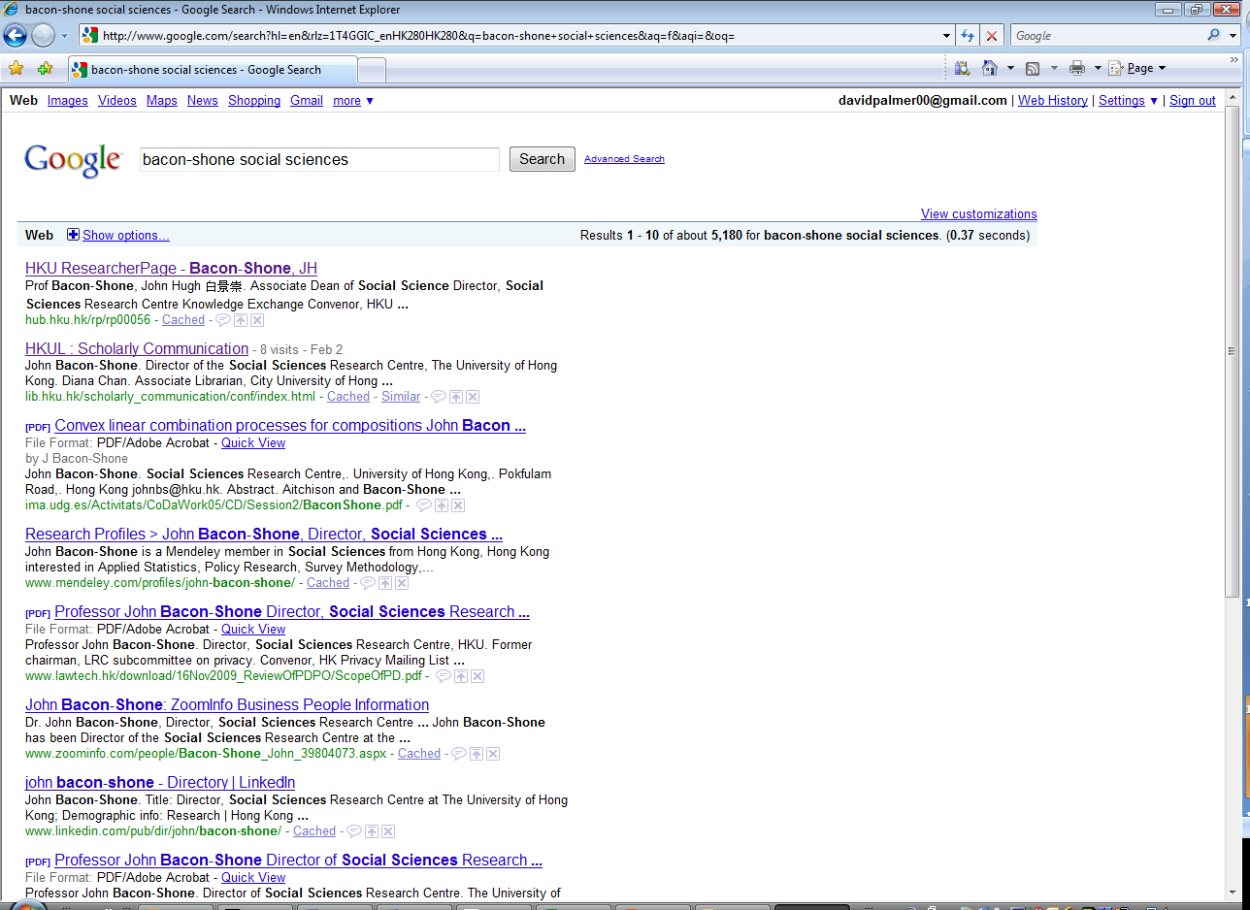
On any relevant search, entry for Hub usually comes top of page
在任何有关的搜索，学术库的项目总是该页的首项

Slide 27
KE: Relevant Key Indicators
知识交流：有关重要指标
Objectively measured by The Hub
  Item count of HKU Theses in Open Access
  Item count of HKU research in Open Access
  Applications for patents
  Download counts of the above
  Number of staff for media contact
基于学术库资料的客观量度
  港大论文开放存取资源的项目数
  港大研究项目开放存取资源的项目数
  专利申请项目数
  上述内容的下载次数
  传媒联络过的职员人数

Slide 28
KE: Relevant Key Indicators
知识交流：有关重要指标
Outcomes, indirectly attributable to The Hub
  Number of collaborative researches
  Number of contract researches
  Number of consultancies, and income thereby generated
  Number of invited public lectures, symposia, exhibitions, performances & honorary degree speeches
  Number of University staff invited to be mentors
  Number of positive media impact related to knowledge transfer coverage, including print, online and electronic media
  Number of appointments of external members to HKU advisory boards
间接归功于学术库的成果
  合作研究项目数
  合同研究项目数
  提供顾问服务次数及因此而产生的收益
  获邀公开演讲，出席研讨会、展览、表现及名誉学位演讲的次数
  获邀为辅导教师的大学职员人数
  产生与知识交流有关的正面媒体效应的次数，包括印刷、网上及电子传媒
  受聘为港大顾问委员会的校外委员人数

Slide 29







HKU Colleagues
港大同僚
Terima Kasih
спасибо
شكرا لك
謝謝您
감사합니다
cảm ơn bạn
धन्यवाद
Σε ευχαριστώ
תודה
有り難うございます
Thank You
da

Slide 30
This PPT & PDF are licensed under a Creative Commons license. This license permits non-commercial use of this work, so long as attribution is given. For more information about the license, visit
http://creativecommons.org/licenses/by-nc-sa/3.0/hk/
Archived at,
  http://hub.hku.hk/handle/123456789/57066

